Slide 1
Software Development Methodology

Slide 2
A software development methodology or system development methodology in software engineering is a framework that is used to structure, plan, and control the process of developing an information system.
There are the following methodologies:
Waterfall model
Agile model
Scrum model
Kanban model

Slide 3
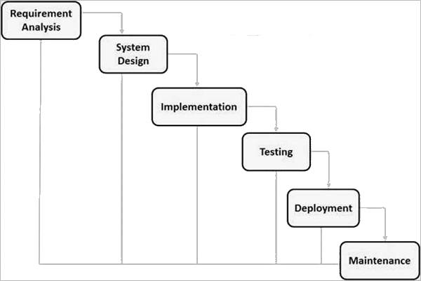
Waterfall model
The waterfall model is a popular version of the systems development life cycle model for software engineering. Often considered the classic approach to the systems development life cycle, the waterfall model describes a development method that is rigid and linear. Waterfall development has distinct goals for each phase of development where each phase is completed for the next one is started and there is no turning back.

Slide 4
Waterfall Model Strengths
Easy to understand, easy to use
Easy to manage, each phase has specific deliverables and a review process.
Milestones are well understood
Sets requirements stability
Good for management control (plan, staff, track)
Works well when quality is more important than cost or schedule

Slide 5
WATERFALL Model Weaknesses
All requirements must be fully specified upfront
Deliverables created for each phase are considered frozen – inhibits flexibility
Can give a false impression of progress
Does not reflect problem-solving nature of software development – iterations of phases
Integration is one big bang at the end
Little opportunity for customer to preview the system (until it may be too late)

Slide 6
When to use the WATERFALL Model
Requirements are very well known
Product definition is stable
Technology is understood
New version of an existing product
Porting an existing product to a new platform.

Slide 7
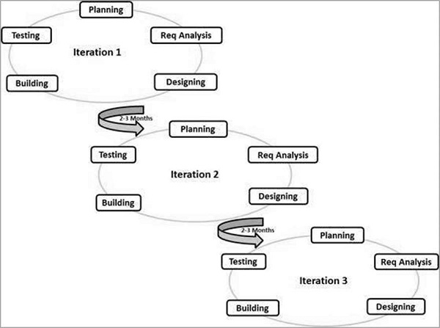
Agile Model
Agile software development is a conceptual framework for undertaking software engineering projects. There are a number of agilesoftware development methodologies e.g. Crystal Methods, Dynamic Systems Development Model (DSDM), and Scrum.
Most agile methods attempt to minimize risk by developing software in short timeboxes, called iterations, which typically last one to four weeks. Each iteration is like a miniature software project of its own, and includes all the tasks necessary to release the mini-increment of new functionality

Slide 8
Agile Model
Agile Methods break the product into small incremental builds. Every iteration involves cross functional teams working simultaneously on various areas like:
- Planning
- Requirements Analysis
- Design
- Coding
- Unit Testing
- Acceptance Testing
At the end of the iteration, a working product is displayed to the customer and important stakeholders.

Slide 9
Agile Model Strengths
Functionality can be developed rapidly and demonstrated.
Customer feedback at every stage ensures that the end deliverable satisfies their expectations
No guesswork between the development team and the customer, as there is face to face communication and continuous inputs from the client
Little or no planning required
Easy to manage
Gives flexibility to developers

Slide 10
Agile Model Weaknesses
For larger projects, it is difficult to judge the efforts and the time required for the project in the SDLC.
Since the requirements are ever changing, there is hardly any emphasis, which is laid on designing and documentation. Therefore, chances of the project going off the track easily are much more
Not suitable for handling complex dependencies
Depends heavily on customer interaction, so if customer is not clear, team can be driven in the wrong direction.
Transfer of technology to new team members may be quite challenging due to lack of documentation

Slide 11
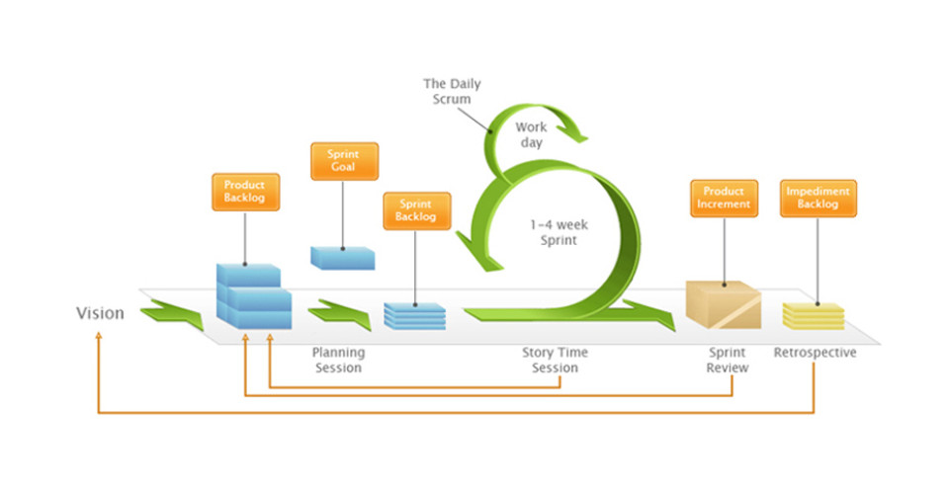
Scrum Model
Scrum is an agile method for project management developed by Ken Schwaber. Its goal is to dramatically improve productivity in teams previously paralyzed by heavier, process-laden methodologies.

Slide 12
Scrum Model
Scrum is characterized by:
A living backlog of prioritized work to be done.
Completion of a largely fixed set of backlog items in a series of short iterations or sprints.
A brief daily meeting (called a scrum), at which progress is explained, upcoming work is described, and obstacles are raised.
A brief planning session in which the backlog items for the sprint will be defined.
A brief heartbeat retrospective, at which all team members reflect about the past sprint.
Scrum is facilitated by a scrum master, whose primary job is to remove impediments to the ability of the team to deliver the sprint goal. The scrum master is not the leader of the team (as they are self-organizing) but acts as a productivity buffer between the team and any destabilizing influences.

Slide 13
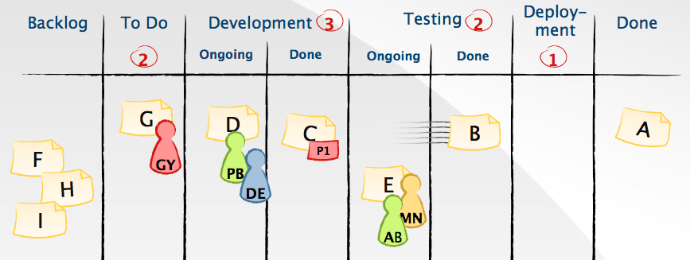
Kanban Model
Kanban is a method for managing the creation of products with an emphasis on continual delivery while not overburdening the development team. Like Scrum, Kanban is a process designed to help teams work together more effectively.

Slide 14
Kanban Three Basic Principles
Visualize what you do today (workflow): seeing all the items in context of each other can be very informative
Limit the amount of work in progress (WIP): this helps balance the flow-based approach so teams don’t and commit to too much work at once
Enhance flow: when something is finished, the next highest thing from the backlog is pulled into play

Slide 15
Kanban Model Strengths
Shorter cycle times can deliver features faster.
Responsiveness to Change:
When priorities change very frequently, Kanban is ideal.
Balancing demand against throughput guarantees that most the customer-centric features are always being worked.
Requires fewer organization / room set-up changes to get started
Reducing waste and removing activities that dont add value to the team/department/organization
Rapid feedback loops improve the chances of more motivated, empowered and higher-performing team members

